Slide 1
TOPIC
LEARNING
BY : GUFRAN ALAM
ASST. PROFESSOR
WTC , P.U , PATNA

Slide 2
TODAY WE WILL DISCUSS
Learning
Components of learning
Characteristics of learning
Transfer of learning
Stages of learning

Slide 3
LEARNING
Learning occurs when experience causes a relatively permanent change in an individual’s knowledge and behaviour.
A/C to JP Guilford
“Learning is any change in behaviour,resulting from behaviour.”
A/C to Garrett
“Learning is that activity by virtue of which,we organise our response with new habits.”

Slide 4
Continue…
Learning is a change in behaviour for better or worse.
It is a change that takes place through practice or experience ,changes due to growth and maturation.
Before it can be calles learning ,the change must be relatively permanent,it must be for a long time.

Slide 5
COMPONENTS OF LEARNING
STUDENT
CURRICULUM TEACHER

Slide 6
CHARACTERISTICS OF LEARNING
Learning is growth
Learning is purposeful
Learning is intelligent
Leaning is both individual and social
Learning affects the conduct of the learner
Learning is adjustment
Learning is experience
Learning is active

Slide 7
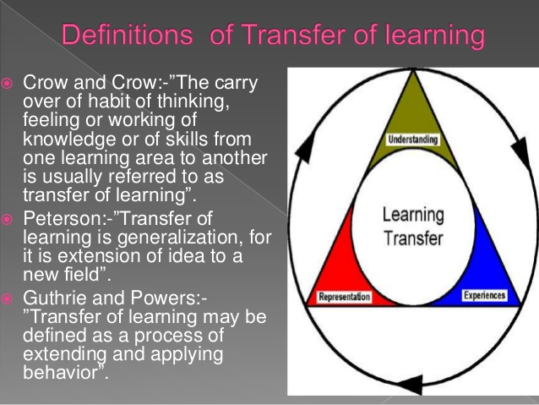
TRANSFER OF LEARNING

Slide 8
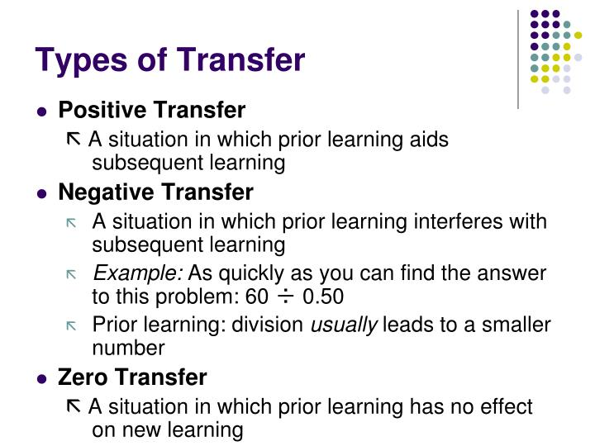
Continue…

Slide 9
STAGES OF LEARNING
There are three important stages in learning and developing skills:-
Planning stage ( cognitive)
Practice stage (associatives)
Automatic stage (autonomous)

Slide 10
Planning stage
Planning stage (Cognitive)
Skill learning goals are set and learning is begun
Trial and error methods used
Improvement is rapid, but movement are jerky and uncoordinated
Use of models and an initial look at techniques
Demands high attention and concentration.

Slide 11
Associative stage
Specific motor programmes and subroutines are developed relevant to sport
Consistency and coordination mprove rapidly , timing and anticipation improve
Comparision of acton with model
Gross error deyection and correction is practised, detailed feedback is utilised
Improvement is less rapid

Slide 12
Autonomous stage
Performance almost automatic ,performed easily without stress
High proficiency with habitual performance and attention demands reduced
Attention can be given to relevant cues and signals from the environment
Emphasis on tactics /stratrgy
Error detects and correct without help

Slide 13
EDUCATIONAL IMPLICATION
The teacher should keep in his mind the individual differences of the learner
The teacher has to choose or use proper method of teaching and techniques .
The students may acquaint with their own progress in learning
It can give them the opportunity o self appraisal

