Slide 1

Creating an inclusive school
Mr.Bivek
Assistant professor
Womens’s training college Patna

Slide 2
Contents-
Introduction.
Meaning and Definition
Concept
Importance and need of inclusive education
conclusion

Slide 3
Introduction-
Inclusive Education is a new approach towards educating the children with disability and learning difficulties with that of normal ones within the same roof. It brings all students together in one classroom and community, regardless of their strengths or weakness in any area,and seeks to maximize the potential of all students. it is one of the most effective way in which to promote an inclusive and tolerant society.

Slide 4
Meaning-
Inclusive Education is defined as a learning environment there promotes full personal, academic and professional development of all learners irrespective of race,class, colour, gender, disability, sexual preference, learning style and language.

Slide 5
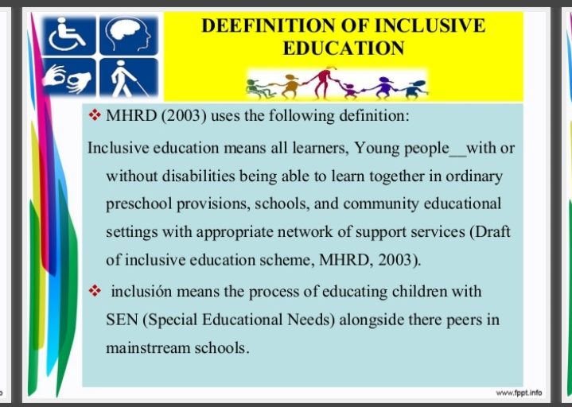

Slide 6
Concept of Inclusive Education-
Inclusive Education is a classroom model where students with special needs are taught in classrooms alongside their general education peers.classroom has both a General Education and special education teacher=co-teaching strategy.
CTT[collaborative team teaching] OR ICT[Integrated co-teaching].

Slide 7
Importance and needs of Inclusive Education-
To fulfill the constructional responsibilities.
To enable children to stay with their families.
For achieving the universalisation.
Developing feeling of self respect.
For the development of healthy citizenship.
For social equality.
Self reliant.

Slide 8
Conclusion-
Inclusive education responding to special needs will must have positive returns for all pupils. All children and young people of the world,with their individual strengths and weaknesses ,with their hopes and expectations,have the right to educatione.It es not our Educatione systems that have a right to a certeain type of children.Therefore,it is the school system of a country that must be adjusted to meet the needs of all its children.
That is a big and difficult task,but “where there is a will there is a way”

